Slide 1

World Wide Web

Slide 2
How ICT use in this application
system that enables content sharing over the Internet through user-friendly ways meant to appeal to users beyond IT specialists and hobbyists.

Slide 3

The Web allows us to browse websites, watch videos, shop online, and connect with others around the world through our computers and phones.
EXAMPLE:
Communication
Education
Business and E-commerce
Entertainment and etc.

Slide 4
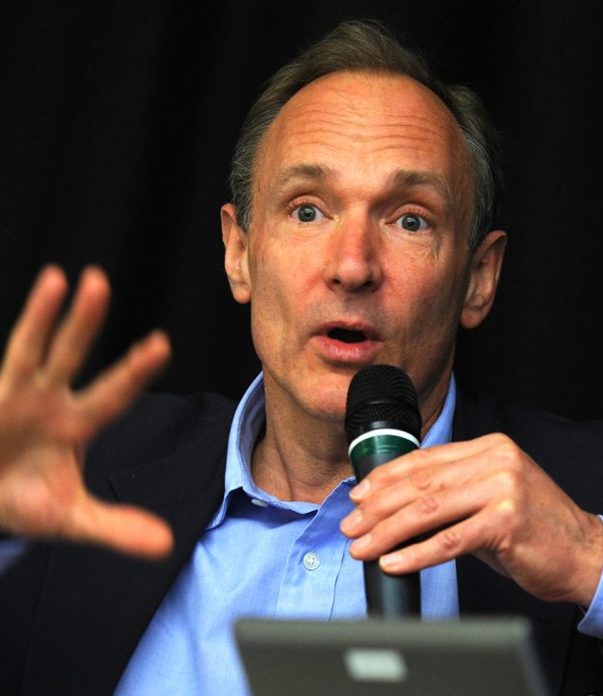
The Web was invented by English computer scientist Tim Berners-Lee while at CERN in 1989 and opened to the public in 1993.
This Photo by Unknown Author is licensed under CC BY

Slide 5
Positive Negative
Makes communication easier and faster.
Improves education and learning.
Helps businesses grow.
Gives entertainment and new opportunities.
People can get addicted to gadgets or social media.
Can spread fake news that can lead into misinformation.
May reduce face-to-face interaction.

Slide 6
The future predictions for how this technology evolved
Several trends are shaping the future of the web. These trends will determine the direction in which the digital world evolves.

Slide 7
1. Decentralization
2. Enhanced Cybersecurity
is a major trend, driven by blockchain technology. This will result in data that is more secure and under greater user control.
With increasing digital threats, cybersecurity is becoming more critical. Future web technologies will focus on robust security measures to protect user data.

Slide 8
3.Virtual and Augmented Reality (VR/AR)
4. Edge Computing
VR and AR will provide immersive experiences, transforming industries like gaming, education, and real estate.
minimizes latency by handling data closer to its source, leading to quicker and more efficient operations.

Slide 9
5. Ethical AI
The future web will emphasize ethical AI, ensuring transparency, fairness, and accountability in AI-driven decisions.

Slide 10
Summary
In the future, ICT will continue to grow and bring many opportunities. It can make life easier by improving communication, education, business, and entertainment. Technologies like decentralization, cybersecurity, VR/AR, and edge computing will make systems faster and safer. there are also challenges such as addiction, fake news, and less face-to-face interaction. For us, the future of ICT is promising, but people must use it wisely and responsibly to enjoy its benefits while avoiding its negative effects.

Slide 11

Thank you

